Slide 1
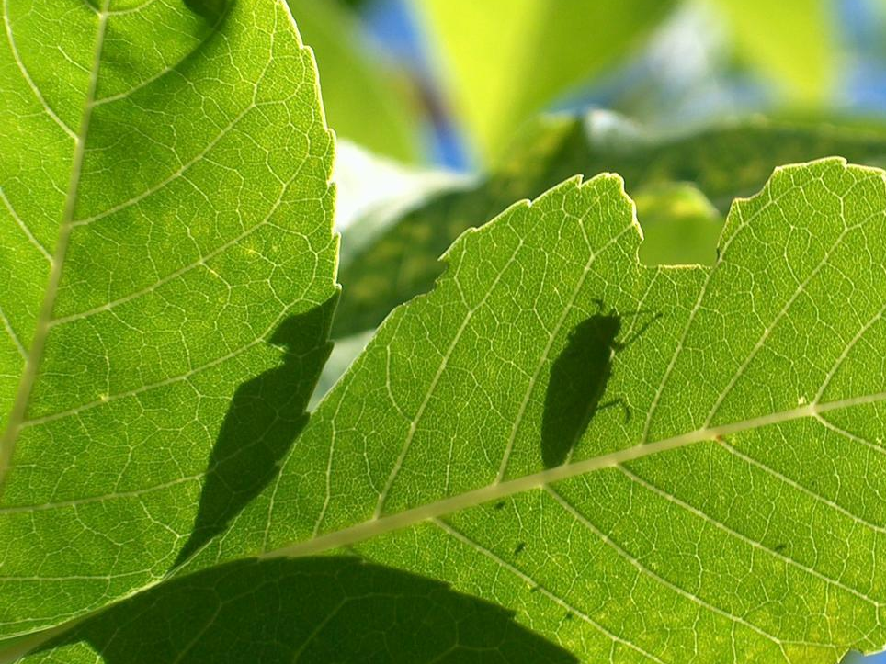
The Problem
Invasive insects are non-native species that lack natural controls. They cause far-reaching environmental and economic damage and can threaten public health.

Slide 2
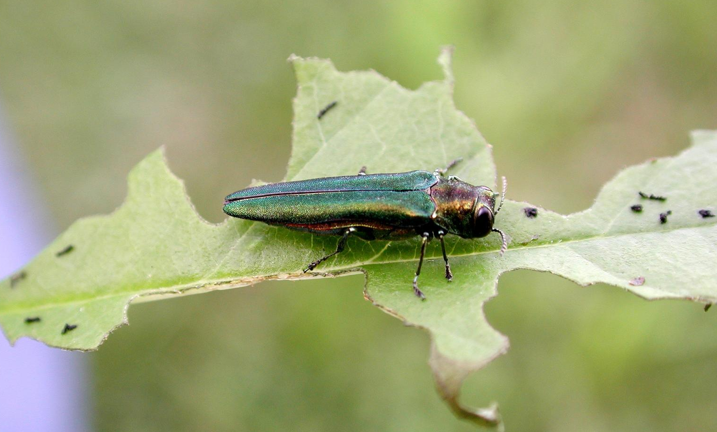
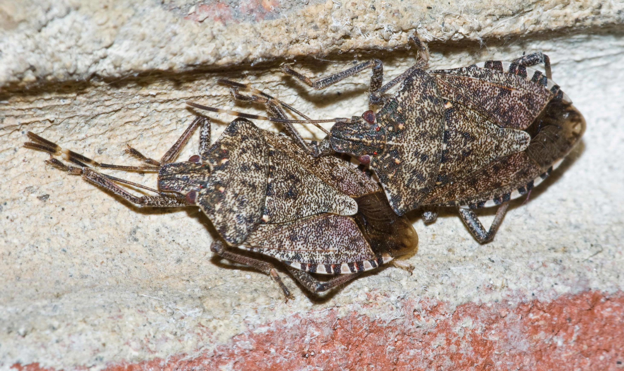
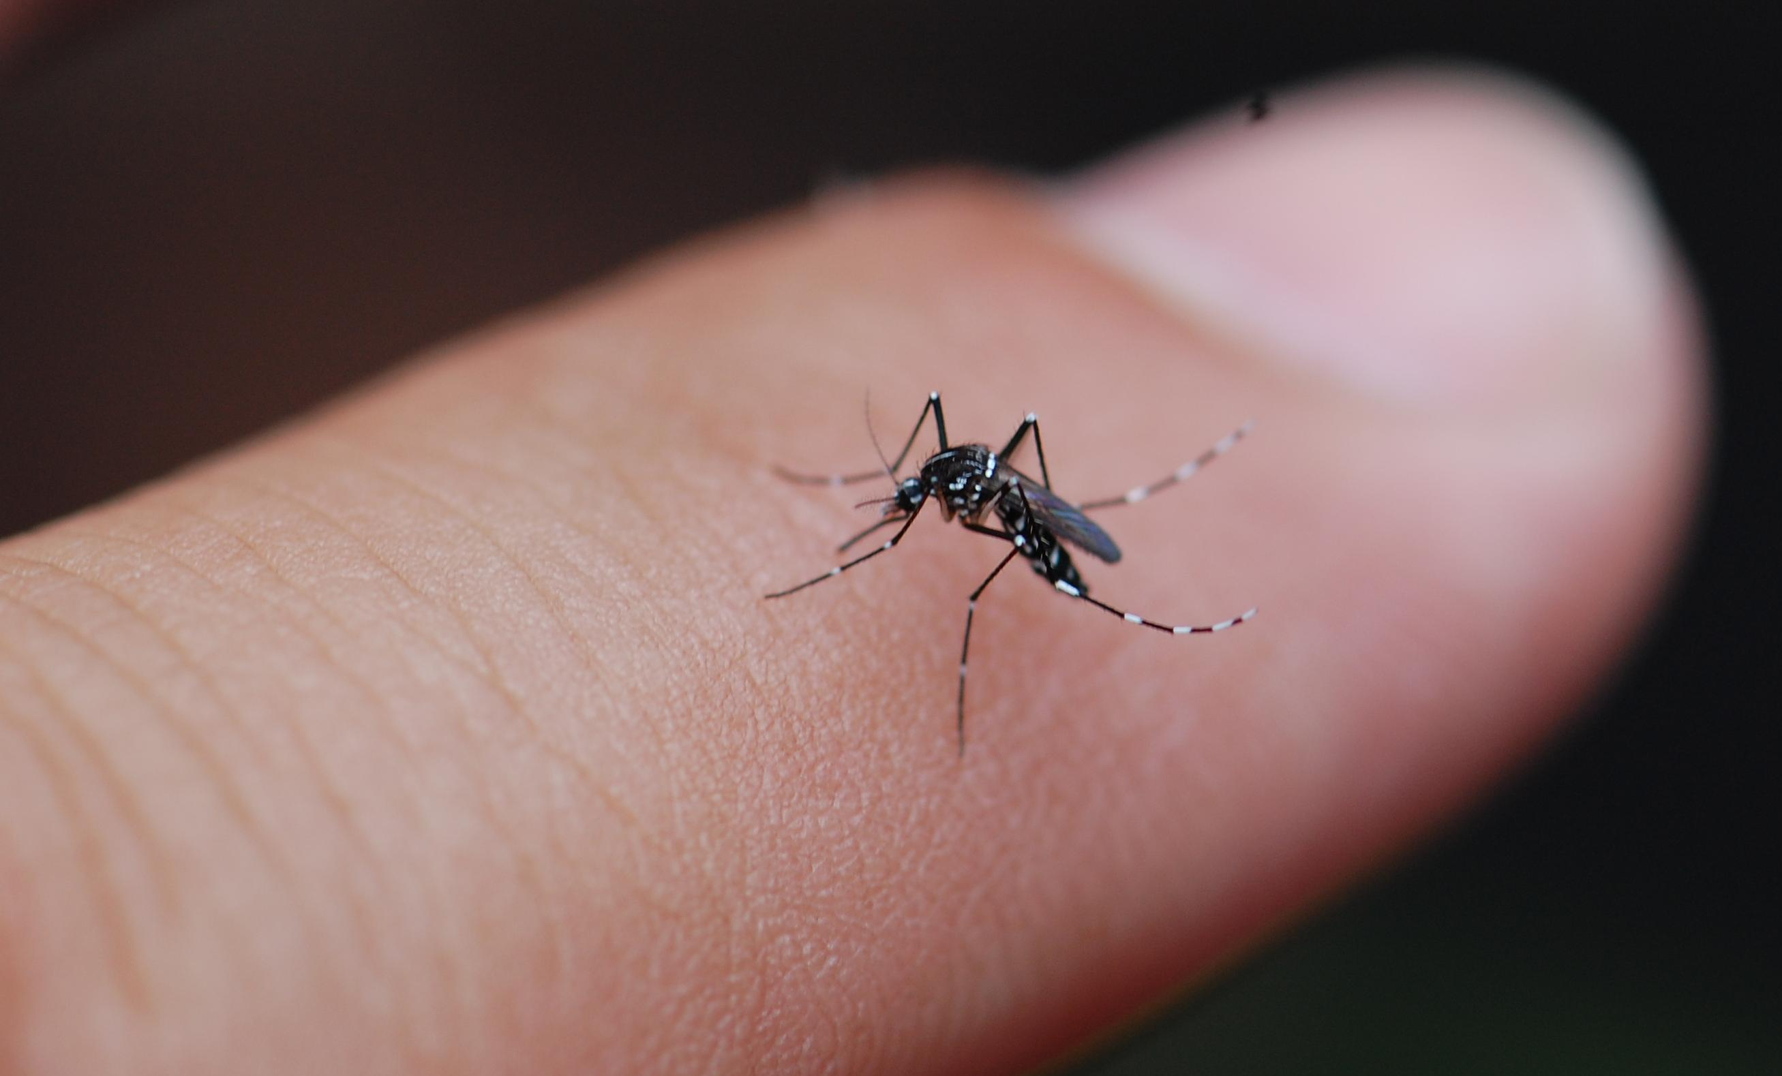
Consequences of Invasive Insects
1
They kill trees, threatening to wipe out native species with significant wildlife and ornamental value.
example: Emerald Ash Borer
2
They damage and destroy crops, causing economic harm to growers and consumers.
example: Brown Marmorated Stink Bug
3
They carry and spread diseases to people and wildlife.
example: Asian Tiger Mosquito

Slide 3
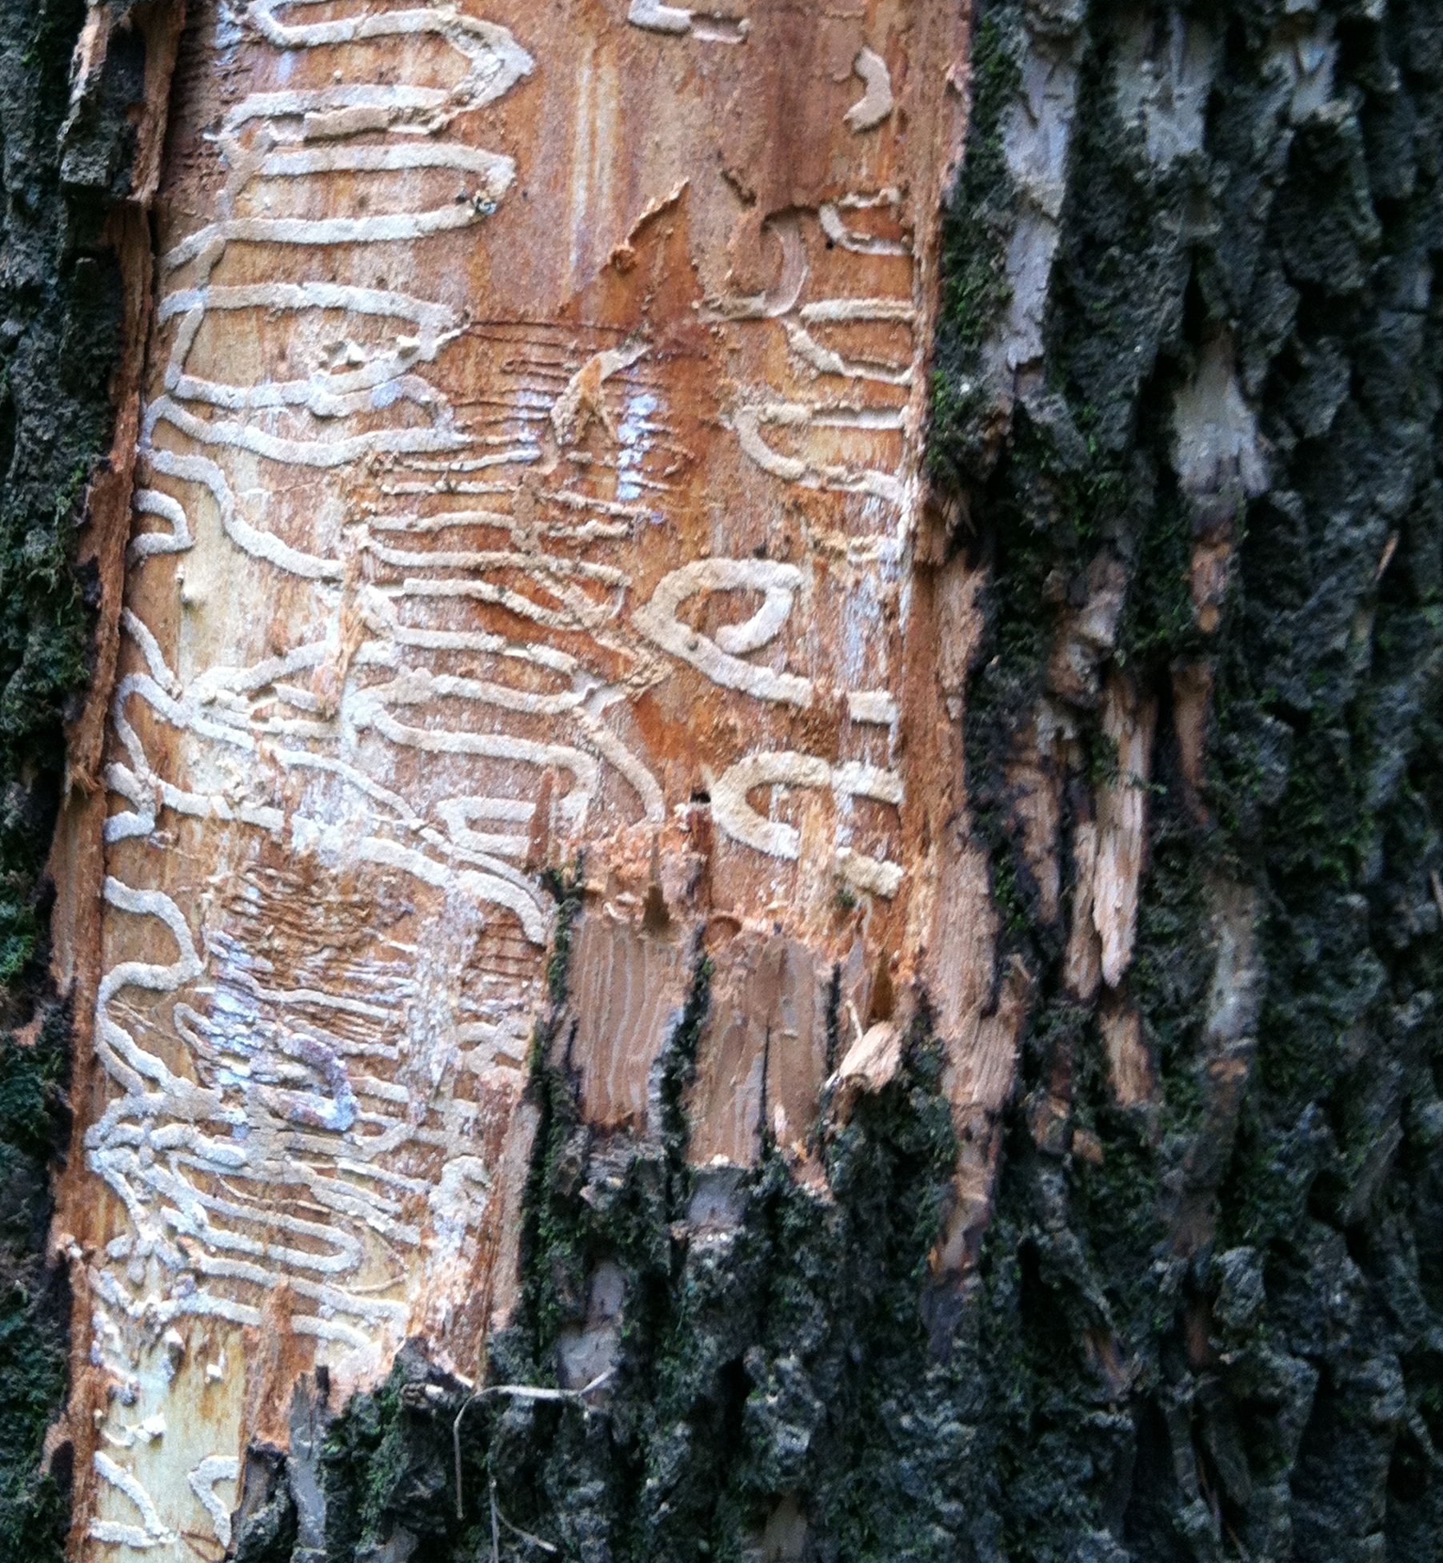
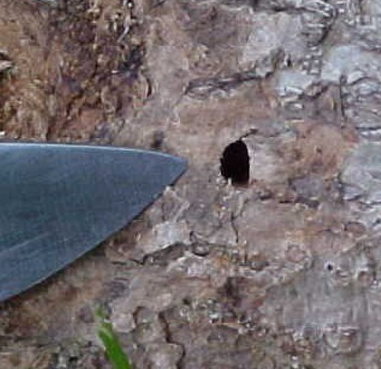
1
What Can You Do about It?
Report Them
When a species is just beginning to invade a region, report sightings to the proper authorities.*
Emerald Ash Borer threatens ½ million ash trees in the Baltimore area. Look out for ash trees with:
foliage wilt & thinning
D-shaped exit holes
unusual woodpecker damage
larval tracks under bark
unusual growth from trunks & limbs
Larval tracks
D-shaped exit hole
* In Maryland, report suspected infestations to the University of Maryland Cooperative Extension or the Maryland Department of Agriculture.

Slide 4
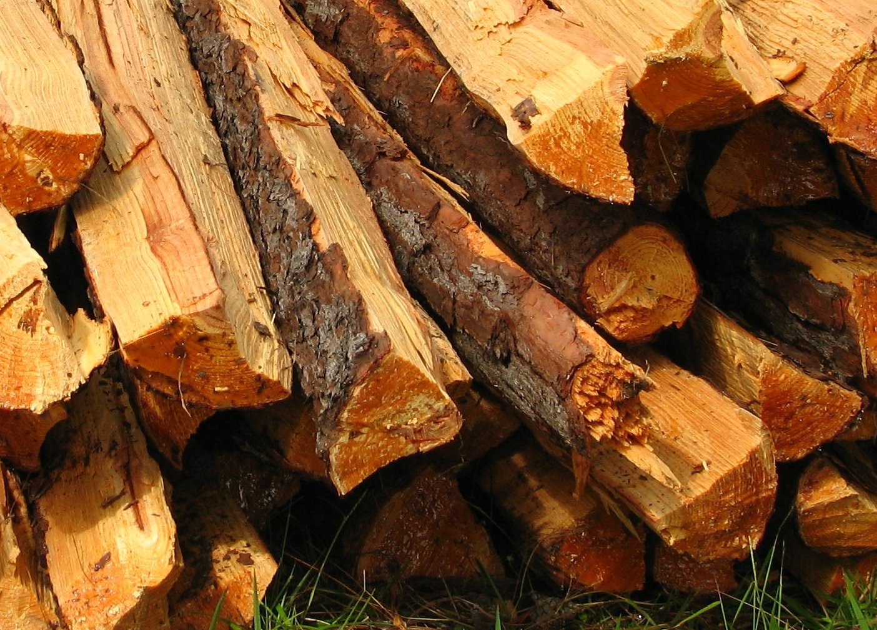
2
What Can You Do about It?
Don’t Spread Them
Insects can hide in firewood. Never transport firewood! Buy it where you burn it.
Invasive insects kill trees, and sometimes those trees end up as firewood. The insects can hitch a ride on the firewood and end up far from their original location, where they establish new populations.
Buy your firewood at your final destination so you don’t spread invasive pests!

Slide 5

3
What Can You Do about It?
Don’t Harbor Them
Eliminate breeding and overwintering sites.
Asian Tiger Mosquitos breed in water.
Drain and remove their breeding sites: tires, clogged gutters, buckets, flower pots, tarps, toys, or anywhere water can collect. Screen rain barrel tops. For bird baths, rinse/refill often or use environmentally safe mosquito dunks.
Brown Marmorated Stink Bugs overwinter in homes.
Keep them out by plugging entry holes with caulk or screens. Dispose of the ones you find in trash or soapy water.

Slide 6
Credits
Photos used under Creative Commons licenses:
https://creativecommons.org/licenses/by/3.0/legalcode
“Emerald Ash Borer” by Debbie Miller, USDA Forest Service, Bugwood.org (cropped)
“Brown Marmorated Stink Bug” by Susan Ellis, Bugwood.org (cropped)
“Asian Tiger Mosquito” by Ary Farajollahi, Bugwood.org (cropped)
“Emerald Ash Borer galleries” by Kelly Oten, North Carolina Forest Service, Bugwood.org (cropped)
“Emerald Ash Borer exit hole” by David R. McKay, USDA APHIS PPQ, Bugwood.org (cropped)
https://creativecommons.org/licenses/by-nc/2.0/legalcode
“Firewood 2” by Aaron Ortiz via flickr.com
https://creativecommons.org/licenses/by-nc/2.0/legalcode
“Old Tires” by Jayme del Rosario via flickr.com (cropped)

